Slide 1
Last Week
This Week
1x2 splitter (TE)
Thesis contents
1x2 splitter (TE)
Manuscript preparation (figure)

Slide 2
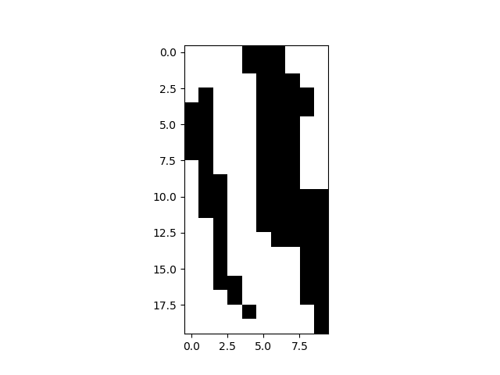
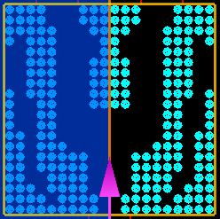
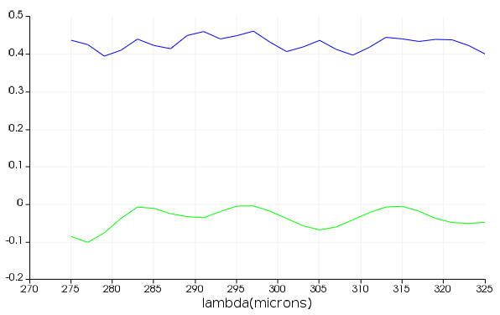
1x2 splitter TM
# of data: 40,000
FOM = T
T
T
E
R
T ~0.43
Transmission
R ~0.05
Power uniformity = 0.71 dB

Slide 3
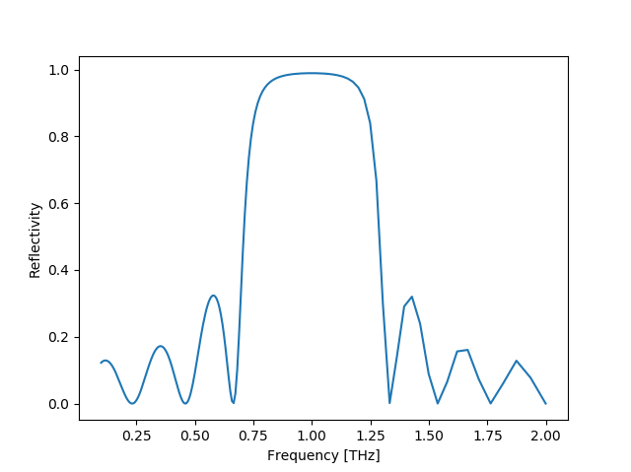
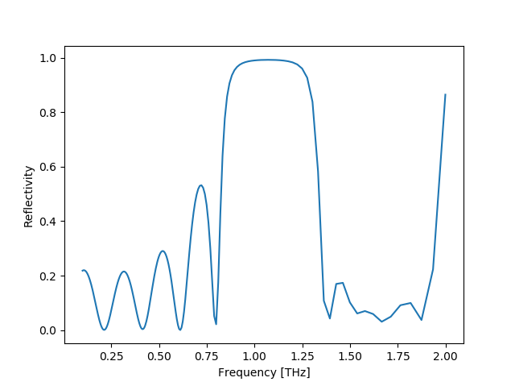
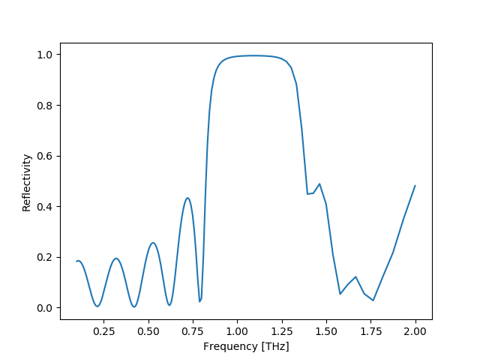
1 THz DBR
Theory
ARL
ANN
99%
FWHM
 | Theory | ARL | ANN
FWHM (THz) | 0.598 | 0.541 | 0.573
99% (THz) | 0.275 | 0.287 | 0.339

Slide 4
1 THz 1x2 splitter
T
T
E
R
T ~0.43
Transmission
R ~0.05
Power uniformity = 0.71 dB

Slide 5
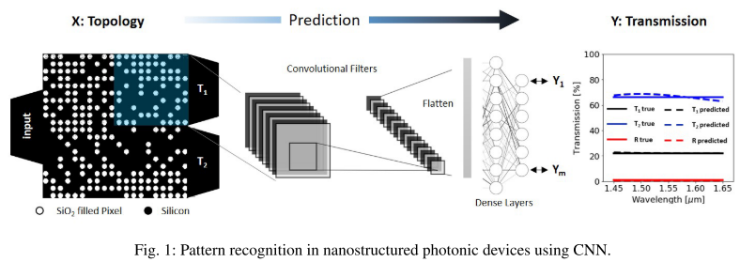
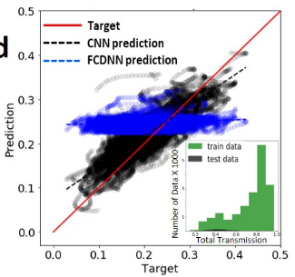
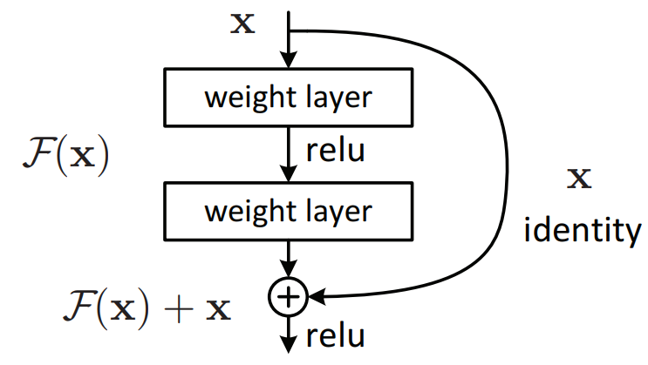
1 THz 1x2 Splitter Output Prediction
M. H. Tahersima, K. Kojima, T. Koike-Akino, D. Jha, B. Wang, C. Lin, and K. Parsons, “Nanostructured Photonic Power Splitter Design via Convolutional Neural Networks,” Conference on Lasers and Electro-Optics, 2019.
E
CNN

Slide 6
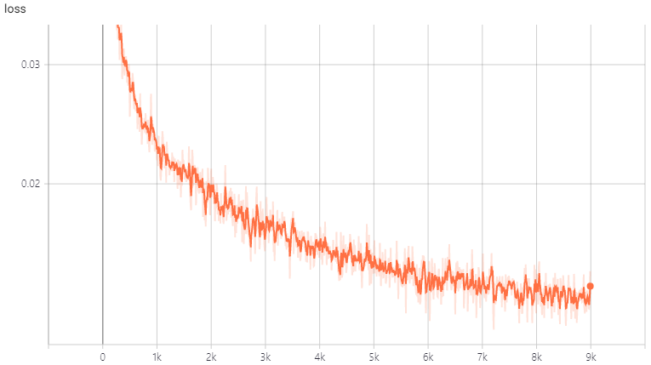
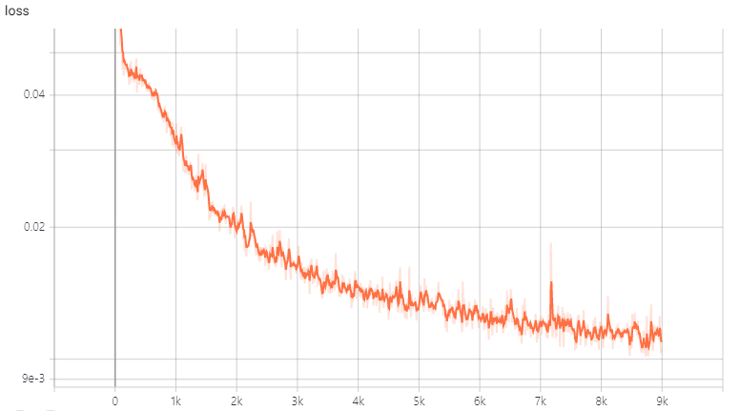
1 THz 1x2 Splitter Output Prediction
$$f\left(x\right)=g\left(x\right)+l(x)$$
FDTD
Neural
Network
loss
$$loss= \left|f\left(x\right)−g\left(x\right)\right|$$
FCNN
~ 0.015
ResNet
Learning Step
~ 0.010
Learning Step

Slide 7

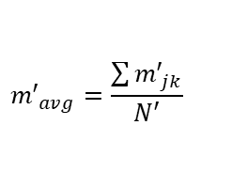
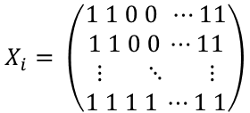


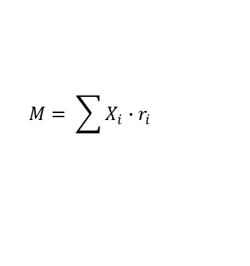





Training Phase
1 for etched (air)
0 for not etched (Si)
Binary matrix
Calculated reward $r_{i}$
from transmission $T_{i}$
$$X_{i}= \left(\begin{aligned}1 1 0 0 ⋯11 \\ 1 1 0 0 ⋯11 \\ ⋮ ⋱ ⋮ \\ 1 1 1 1 ⋯1 1\end{aligned}\right)$$
$$X_{i}, r_{i}$$
Inference Phase
Accumulate the reward in a summation matrix M
$$M= \sum{X_{i}∙r_{i}}$$
Normalizing summation matrix M’
$$m_{min}=\min{m_{jk}}$$
$$m_{jk}^{′}=m_{jk} −m_{min}$$
Activation function
$$x_{lm}^{′}$$
$${m′}_{avg}=\frac{\sum{{m′}_{jk}}}{N′}$$
1
$$x_{lm}^{′}=\left\{\begin{aligned}1 if m_{lm}^{′}≥{m′}_{avg} \\ 0 if m_{lm}^{′}<{m′}_{avg}\end{aligned}\right.$$
0
$${m′}_{avg}$$
$$m_{jk}$$

Slide 8
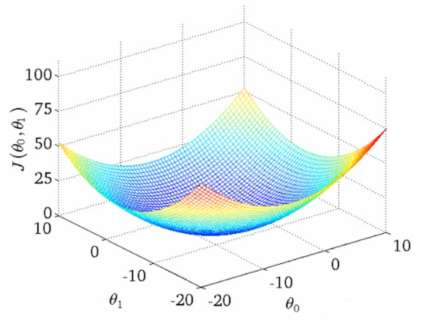
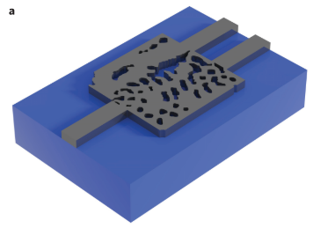
Inverse Design Process
FDTD
$x_{A}$
$$f\left(x\right)$$
$$y_{A}$$
$${FOM}_{A}$$
structure
spectrum
minimize
Cost function
$$\frac{1}{FOM_{A}}, Const.−FOM_{A}$$
Minimize by gradient descent algorithm
Gradient
$$Cost$$
$x_{A, ij}$
A. Y. Piggott et al., Nature Photonics, vol. 9, no. 6, pp. 374–377, Nov. 2015.

Slide 9
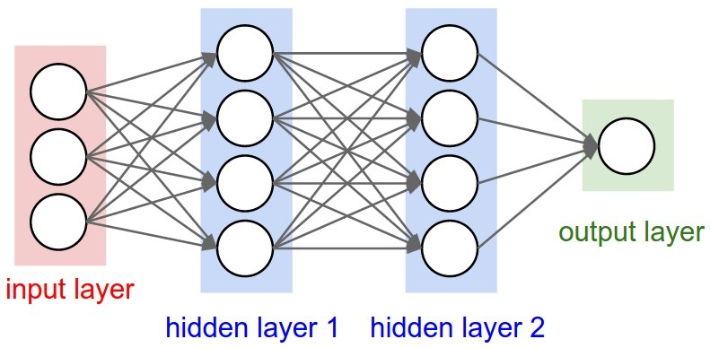
Inverse Design Process
Learning
Neural
Network
$x_{A}$
$$f\left(x\right)$$
$$y_{A}$$
$${FOM}_{A}$$
structure
spectrum
minimize

Slide 10
Inverse Design Process
bias
Perceptrons (1957)
b
Training Data
x | y
1 | 2
2 | 3
3 | 4
x
1
2
3
Activation
function
y
2
3
4
weight
:
x
w
wx+b
y
$$Cost=\frac{1}{m}\sum_{i=1}^{m}{{\left(wx^{\left(i\right)}+b−y^{\left(i\right)}\right)}^{2}}$$
Gradient
$$Cost$$
$$W$$
$$b$$

Slide 11
Inverse Design Process
bias
Perceptrons (1957)
b
Training Data
x | y
1 | 2
2 | 3
3 | 4
x
1
2
3
Activation
function
y
2
3
4
weight
:
x
w
wx+b
y
b = 1
w = 1
bias
1
Activation
function
x
4
weight
y
5
x
1
wx+b
y

Slide 12
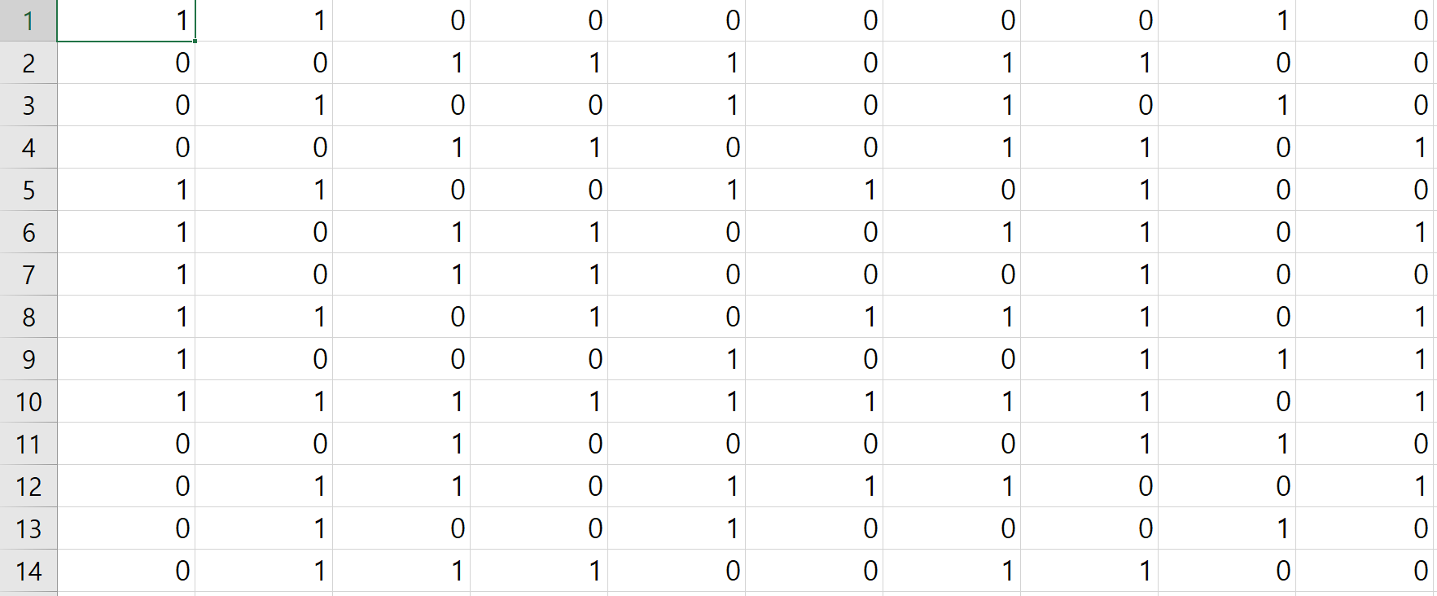
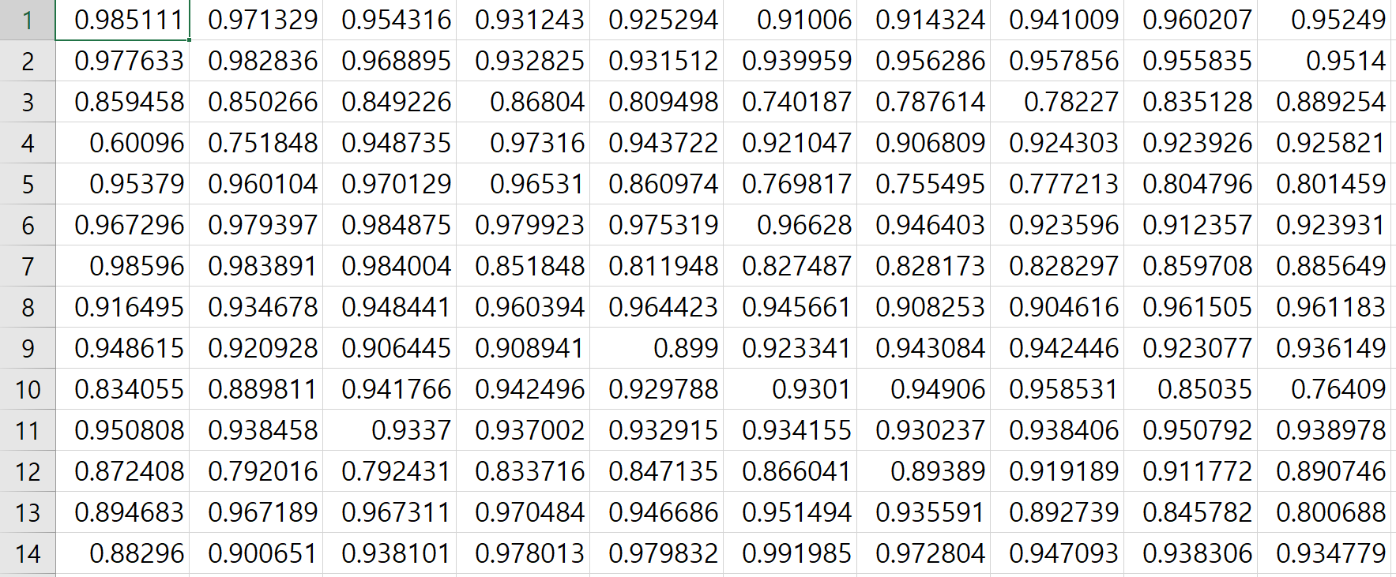
Inverse Design Process
Multi-Layer Perceptrons (MLP)
structures
spectrum
Neural
Network
$x_{A}$
$$f\left(x\right)$$
$$y_{A}$$
$${FOM}_{A}$$
structure
spectrum
minimize

